Slide 1
GIS应用开发
Developing GIS Applications with ArcObjects using C#.NET
江西省研究生优质课程
主讲：兰小机 GIS博士、教授
Email : landcom8835@163.com
QQ ：305333315
      课件： ftp://218.87.136.94/

Slide 2
Chap.9 空间查询与空间分析 (4学时)
本章内容：
  空间查询基础
  属性条件查询
  基于空间位置、空间关系的查询
  缓冲区查询
  邻接多边形查询
  空间分析基础
  地学处理工具—Geoprocessing Tools
  缓冲区分析
  空间叠加分析
  网络分析

Slide 3
9.1 空间查询基础
  Cursor对象
  QueryFilter与SpatialFilter对象
  QueryDef对象
  TableSort对象

Slide 4
9.1.1 Cursor对象
游标Cursor对象本质上是一个指向数据的指针，本身并不包含数据内容，它只是提供了一个链接到Row对象或要素对象的桥梁而已。
游标有三种类型，即查询游标、插入游标和更新游标。每一种游标都是通过与之相适应的方法来获得的，如Search、Insert和Update方法。

Slide 5
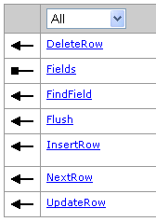
Cursor对象支持的接口是ICursor.
  ICursor pCursor = ITable::Insert (bool useBuffering)
    Insert方法返回一个插入型游标，它通常用于往表中插入一批记录。
  ICursor pCursor = ITable::Update (IQueryFilter QueryFilter, bool Recycling)
    Update方法会返回一个更新型游标，它用于更新或者删除一批记录。
  ICursor Cursor=ITable::Search( IQueryFilter QueryFilter, bool Recycling)
    使用ITable::Search方法对表进行查询后，可以得到一个查询型Cursor对象，它指向一个或多个Row对象。

Slide 6
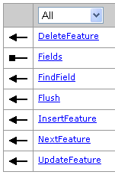
  IRow prow = pCursor.NextRow();
  while (prow != null)
  { //…….对Row对象进行操作
  prow = pCursor.NextRow();
  }
FeatureCursor是Cursor的一个子类，指向一个或多个要素。它实现了IFeatureCursor接口，这个接口定义的属性和方法与ICursor类似。

Slide 7
IFeatureClass
  public IFeatureCursor Insert ( bool useBuffering);
  public IFeatureCursor Search ( IQueryFilter filter, bool Recycling);
  public IFeatureCursor Update ( IQueryFilter filter, bool Recycling);

Slide 8
  // IFeatureLayer pFeatlyr
  IFeatureCursor pCursor = pFeatlyr.search ( null,false ); //返回游标对象
  IFeature pFeat = pCursor.NextFeature(); //下面做一个循环可以遍历游标指向的要素
  while (pFeat != null)
  {
  //.......
  pFeat = pCursor.NextFeature();
  }

Slide 9
9.1.2 QueryFilter与SpatialFilter对象
在关系数据库中，查询条件是使用SQL语句的WHERE子语句完成的。
ArcObjects中，可以使用查询过滤器(QueryFilter与SpatialFilter)来实现数据选择目的。
QueryFilter filters data based on attribute values and or relationships between attributes.
SpatialFilter filters data based on spatial and attribute constraints.

Slide 10
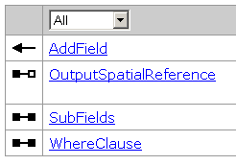
IQueryFilter接口
  WhereClause 语法格式详见AO库参考。
  不同的数据源， WhereClause 的语法不一样。
  字段名：
    in a file geodatabase, shapefile, dBase table, coverage, INFO table： "AREA "
    in a personal geodatabase： [AREA]
    in an ArcSDE geodatabase： AREA
  字符串：
    Strings must always be enclosed within single quotes. For example:
      "STATE_NAME" = 'California’
    Personal geodatabases stored in Access are case insensitive to field values, whereas ArcSDE, File and shapefiles are case sensitive.
  通配符：

Slide 11
WHERE clause syntax for a personal geodatabase | Equivalent syntax for a file geodatabase
[STATE_NAME] = 'California' | "STATE_NAME" = 'California'
[OWNER_NAME] LIKE ‘*smith’ | "OWNER_NAME" LIKE ‘%smith’
[OWNER_NAME] LIKE '?atherine smith' | "OWNER_NAME" LIKE '_atherine smith'
[STATE_NAME] = 'california' (when a case-insensitive search is required) | LOWER("STATE_NAME") = 'california'
UCASE([LAST_NAME]) = 'JONES' | UPPER("LAST_NAME") = 'JONES'
[DATE_OF_BIRTH] = #06-13-2001 19:30:00# | "DATE_OF_BIRTH" = date '2001-06-13 19:30:00'

Slide 12
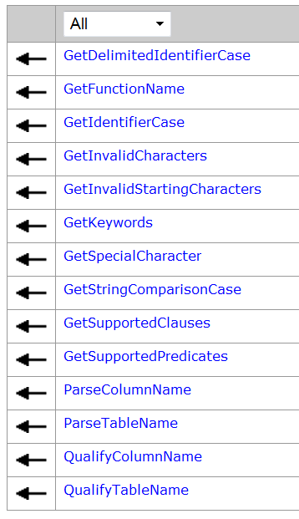
Use ISQLSyntax::GetSpecialCharacter to return the delimited identifier prefix and suffix for the data source.

Slide 13
Constant | Value | Description
esriSQL_WildcardManyMatch | 1 | SQL Wildcard Match.
esriSQL_WildcardSingleMatch | 2 | SQL Wildcard Single Match.
esriSQL_DelimitedIdentifierPrefix | 3 | SQL Identifier Quote Char Prefix.
esriSQL_DelimitedIdentifierSuffix | 4 | SQL Identifier Quote Char Suffix.
esriSQL_EscapeKeyPrefix | 5 | SQL Escape Key Prefix.
esriSQL_EscapeKeySuffix | 6 | SQL Escape Key Suffix.

Slide 14
The GetSpecialCharacter can be used to return the DBMS dependent character that represents an SQL special character, including the following:
  esriSQL_WildcardManyMatch ( % in SQL_92, * in Jet 4.0)
  esriSQL_WildcardSingleMatch ( _ in SQL_92, ? in Jet 4.0)
  esriSQL_DelimitedIdentifierPrefix ( " in SQL_92, [ in Jet 4.0)
  esriSQL_DelimitedIdentifierSuffix (" in SQL_92, ] in Jet 4.0)

Slide 15

IQueryFilter pQueryFilter = new QueryFilterClass();
//设置过滤器对象的属性
pQueryFilter.WhereClause = "STATE_NAME = 'California'";
IFeatureSelection pFeatureSelection = pFeatureLayer as IFeatureSelection; pFeatureSelection.SelectFeatures(pQueryFilter, esriSelectionResultEnum.esriSelectionResultNew, false);

Slide 16
如果在选择的过程中不过滤任何的记录，而是返回所有的数据，则可以使用关键字“null”来替代pQueryFilter对象：
pFeatureSelection.SelectFeatures(null, esriSelectionResultEnum.esriSelectionResultNew, false);
如用户如果希望知道一个要素类中的要素数目：
pFeatureClass.FeatureCount(null)

Slide 17
ISpatialFilter
ISpatialFilter继承IQueryFilter，如果要查询“在100米内的电话亭有哪些?” ，就要使用ISpatialFilter.
用户可以进行的空间过滤范围非常广泛，如
  寻找与某个选择区域相覆盖的要素
  寻找某个要素附近的对象
ISpatialFilter对象就包含了空间属性和普通属性两种条件。
  如需要查询“在某一点2000米范围内的服装店”

Slide 18
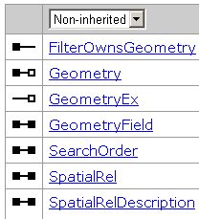
ISpatialFilter过滤器 三个必须的属性：
  Geometry；
  GeometryField；
  SpatialRel
ISpatialFilter::SearchOrder属性用于设置选择顺序，默认先空间后非空间
  esriSearchOrderSpatial ,0,Spatial query is applied first.
  esriSearchOrderAttribute,1,Attribute query is applied first.
SpatialRelDescription： A nine character string containing describing the spatial relationships to be tested by the spatial filter. Required when setting the SpatialRel property to use the esriSpatialRelRelation enumerator.如：
  ’ TT*FFT***’

Slide 19
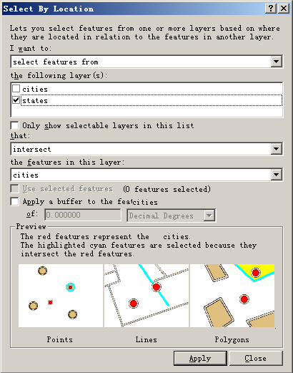

Slide 20
esriSpatialRelEnum Constants
Constant | Value | Description
esriSpatialRelUndefined | 0 | No Defined Spatial Relationship.
esriSpatialRelIntersects | 1 | Query Geometry Intersects Target Geometry.
esriSpatialRelEnvelopeIntersects | 2 | Envelope of Query Geometry Intersects Envelope of Target Geometry.
esriSpatialRelIndexIntersects | 3 | Query Geometry Intersects Index entry for Target Geometry (Primary Index Filter).
esriSpatialRelTouches | 4 | Query Geometry Touches Target Geometry.
esriSpatialRelOverlaps | 5 | Query Geometry Overlaps Target Geometry.
esriSpatialRelCrosses | 6 | Query Geometry Crosses Target Geometry.
esriSpatialRelWithin | 7 | Query Geometry is Within Target Geometry.
esriSpatialRelContains | 8 | Query Geometry Contains Target Geometry.
esriSpatialRelRelation | 9 | Query geometry IBE(Interior-Boundary-Exterior) relationship with target geometry.

Slide 21
ISpatialFilter 实例
  ISpatialFilter pFilter = new SpatialFilterClass();
  //设置空间过滤器的三个必须属性
  pFilter.Geometry = pPoint;
  pFilter.GeometryField = "SHAPE";
  pFilter.SpatialRel = esriSpatialRelEnum.esriSpatialRelIntersects;
  IFeatureCursor pFeatureCursor = pFeatureClass.Search(pFilter, false);

Slide 22
9.1.3 QueryDef对象
QueryDef对象代表了数据库中基于一个或多个表、要素类进行的属性查询。通过这个对象，用户可以在多个表间建立连接，并且保证在这个连接基础上的查询可以实现。
QueryDef中的表必须放在一个工作空间内，而QueryDef对象也是使用IFeatureWorkspace::CreateQueryDef方法来产生的，它并不是一个组件类。
QueryDef不能在Shapefile和Coverage数据中使用，而仅仅可以使用在GeoDatabase数据库中。
QueryDef的查询结果是Cursor对象返回的 ，没有和它们的父表相关联 ，不能使用store方法。
IFeatureWorkspace::OpenFeatureQuery方法会产生一个基于QueryDef对象的要素类，可以加入到Map中。

Slide 23
QueryDef 实例
  //产生一个QueryDef对象
  IQueryDef pQueryDef = pFeatureWorkspace.CreateQueryDef();
  //基于连接的两个表必须是在一个工作空间内，设置它的各种属性
  pQueryDef.Tables = "Counties,States";
  pQueryDef.SubFields = "Counties.Shape,Counties.NAME,States.STATE_ABBR";
  pQueryDef.WhereClause = "Counties.STATE_FIPS = States.STATE_FIPS";

Slide 24
//基于上面产生的QueryDef对象来新建一个虚要素类
  IFeatureDataset pFeatureDataset = pFeatureWorkspace.OpenFeatureQuery("My counties join ", pQueryDef);
  IFeatureClassContainer pFeatureClassContainer = pFeatureDataset as IFeatureClassContainer;
  IFeatureClass pFeatureClass = pFeatureClassContainer.get_Class(0);
  IFeatureLayer pFeatureLayer = new FeatureLayerClass();
  pFeatureLayer.FeatureClass = pFeatureClass;
  pFeatureLayer.Name = pFeatureClass.AliasName;
  pMap.AddLayer(pFeatureLayer);
Opens a feature dataset containing a single feature class defined by the specified Query.
public IFeatureDataset OpenFeatureQuery ( string QueryName, IQueryDef QueryDef );

Slide 25
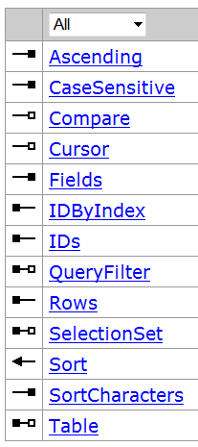
9.1.4 TableSort对象
ITableSort
TableSort对象是表的排序对象，它可以将查找的结果按照某个字段进行排序，然后返回所有符合条件的要素游标。
TableSort必须被设置属性：
  Table
  Fields--是一个用于排序的字段列表 ，排序方式Ascending、CaseSensitive 等
实例分析（见p440）

Slide 26
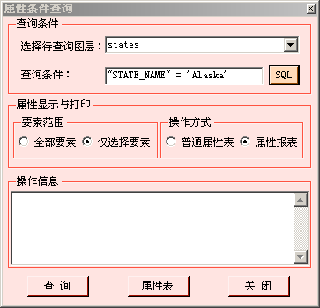
9.2 属性条件查询
根据属性条件查找满足条件的地理要素。

Slide 27
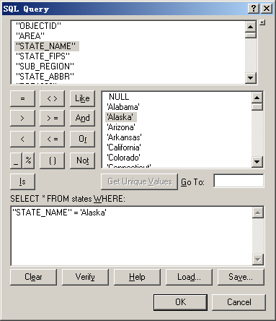
  先选择要查询的图层
  再通过SQLQueryDialog构造查询条件
  最后通过QueryFilter选择图层中满足条件的地理要素。

Slide 28
主要实现代码
public partial class AttributeQuery : Form
  { IHookHelper m_hookhelper;
  IActiveView m_activeview; IMap m_map;
  bool boolDisplayViaReport = true;
  bool boolDisplaySelectedFeature = true;
  public AttributeQuery (IHookHelper hookhelper)
  { InitializeComponent();
  m_hookhelper = hookhelper;
  m_map = m_hookhelper.FocusMap ;
  m_activeview = m_hookhelper.ActiveView;
  }

Slide 29
  IActiveViewEvents_Event activeViewEvent = null;
  IActiveViewEvents_SelectionChangedEventHandler mapSelectionChanged;
  private void SetupEvents()
  { activeViewEvent = m_activeview as IActiveViewEvents_Event;
  mapSelectionChanged = new IActiveViewEvents_SelectionChangedEventHandler(OnMapSelectionChanged);
  activeViewEvent.SelectionChanged += mapSelectionChanged;
  }
  private void OnMapSelectionChanged()
  { m_activeview.PartialRefresh(esriViewDrawPhase.esriViewGeoSelection, null, m_activeview.Extent);
  }

Slide 30
private void AttributeQueryFrm_Load(object sender, EventArgs e)
  { IEnumLayer Layers = GetLayers();
  Layers.Reset();
  ILayer Layer = Layers.Next();
  while (Layer != null)
  { cboLayer.Items.Add(Layer.Name.ToString());
  Layer = Layers.Next(); }
  SetupEvents()
  }
  private IEnumLayer GetLayers()
  { UID uid = new UIDClass();
  uid.Value = "{40A9E885-5533-11d0-98BE-00805F7CED21}";// IFeatureLayer
  IEnumLayer Layers = m_map.get_Layers(uid, true);
  return Layers;
  }

Slide 31
private void btnSql_Click(object sender, EventArgs e)
  { string strLayer = cboLayer.Text.Trim();
  IFeatureLayer pFeatLayer = GetFeatureLayer(strLayer);
  txtExpression.Text = GetSqlQuery(pFeatLayer); }
  private string GetSqlQuery(IFeatureLayer pLayer)
  { if (pLayer == null) return string.Empty;
  ISQLQueryDialog2 sqlQuery = new SQLQueryDialogClass();
  sqlQuery.DoModalEx("", pLayer, this.Handle.ToInt32());
  string strSqlQuery = sqlQuery.SQLQuery;
  return strSqlQuery; }
public bool DoModalEx (
string initialSqlQuery, IFeatureLayer pLayer, int hwnd );

Slide 32
private IFeatureLayer GetFeatureLayer(string strLayer)
  { IEnumLayer Layers = GetLayers();
  Layers.Reset();
  ILayer Layer = Layers.Next();
  while (Layer != null)
  {
  if (Layer.Name == strLayer)
  return Layer as IFeatureLayer;
  Layer = Layers.Next();
  }
  return null;
  }

Slide 33
private void btnQuery_Click(object sender, EventArgs e)
  { m_map.ClearSelection();
  string strLayer = cboLayer.Text;
  string strSqlExpression = txtExpression.Text;
  IFeatureLayer pFeatLayer = GetFeatureLayer(strLayer);
  sqlQueryFilter (pFeatLayer, strSqlExpression); }
private void sqlQueryFilter (IFeatureLayer pFeatLayer, string strExpression)
  { IQueryFilter pQueryFilter = new QueryFilterClass();
  pQueryFilter.WhereClause = strExpression;
  IFeatureSelection pFeatureSelection = pFeatLayer as IFeatureSelection;
  pFeatureSelection.SelectFeatures(pQueryFilter, esriSelectionResultEnum.esriSelectionResultNew, false);
  }

Slide 34
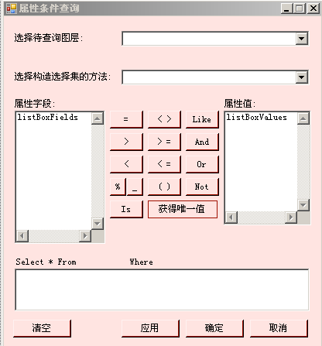

Slide 35
9.3 基于空间位置、空间关系的查询
根据查询的几何形状和空间关系，对所选择的要素图层进行查询。

Slide 36
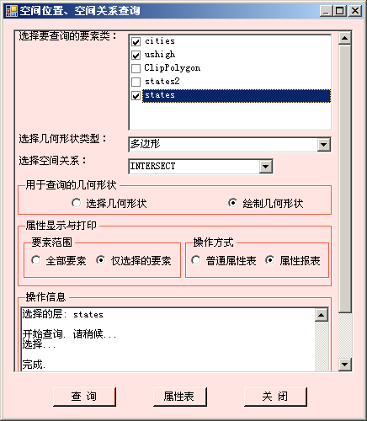

Slide 37
操作步骤：
  选择要查询的要素图层；
  选择用于查询的几何形状类型：点、线、矩形、圆和多边形；
  根据选择的几何形状类型，在图上选择或绘制用于查询的几何形状；
  选择空间关系；
  执行查询。

Slide 38
SelectLayerByLocation—one geoprocessing tool
  in_layer: The input feature layer name.
  overlap_type: The spatial relationship
  select_features: The features in the input layer will be selected based on their spatial relationship to the features from this layer or feature class. (In, Optional)
  search_distance: If the Overlap Type is set to WITHIN_A_DISTANCE, set this parameter to the desired distance. If you choose a different Overlap Type, the Search Distance option lets you apply a buffer to the features in the input layer. (In, Optional)
  selection_type: NEW_SELECTION /ADD_TO_SELECTION/ REMOVE_FROM_SELECTION / SUBSET_SELECTION /SWITCH_SELECTION

Slide 39
主要代码
public partial class SpatialExtentQuery : Form
  { IHookHelper m_hookHelper = null;
  IActiveView m_activeView = null; IMap m_map = null;
  IMapControl3 m_mapControl = null;
  string strGeometryType = "";
  string strSpatialRelationship = "";
  IGeometryCollection queryGeometry;
  static string tempFeatureLayerName = "TempLayerXXX";//存储查询几何形状的临时图层
  IFeatureClass queryFeatureClass;//存储查询几何形状的临时要素类
  bool displaySelectedFeatures = true;
  bool displayViaReport = true;

Slide 40
  public SpatialExtentQuery(IHookHelper hookHelper)
  { InitializeComponent();
  m_hookHelper = hookHelper;
  m_activeView = m_hookHelper.ActiveView;
  m_map = m_hookHelper.FocusMap;
  if (m_hookHelper.Hook is IToolbarControl)
  { IToolbarControl toolbarControl = m_hookHelper.Hook as IToolbarControl;
  m_mapControl = (IMapControl3)toolbarControl.Buddy; }
  if (m_hookHelper.Hook is IMapControl3)
  m_mapControl = m_hookHelper.Hook as IMapControl3;
  }

Slide 41
private void SpatialExtentQueryForm_Load(object sender, EventArgs e)
  { if (m_hookHelper == null || null == m_hookHelper.Hook || 0 == m_hookHelper.FocusMap.LayerCount) return;
  IEnumLayer layers = GetLayers();
  if (layers == null) return ;
  layers.Reset();
  ILayer layer = null;
  while ((layer = layers.Next()) != null)
  { chklstLayers.Items.Add(layer.Name, false); }
  }
public int Add( Object item, bool isChecked )

Slide 42
private void cboGeometryType_SelectedIndexChanged (object sender, EventArgs e)
  { if (cboGeometryType.SelectedItem == null) return;
  strGeometryType = cboGeometryType.SelectedItem.ToString();
  }
  private void cboSpatialRelationship_SelectedIndexChanged (object sender, EventArgs e)
  { if (cboSpatialRelationship.SelectedItem == null) return;
  strSpatialRelationship = cboSpatialRelationship.SelectedItem.ToString();
  if (strSpatialRelationship == "WITHIN_A_DISTANCE")
  txtDistance.Visible = true; }

Slide 43
private void rdoDrawGeom_Click(object sender, EventArgs e)
  { if (rdoDrawGeom.Checked)
  { m_map.ClearSelection();
  initialize();
  SetCurrentSketchTool();
  }
  }
  private void rdoSelGeom_Click(object sender, EventArgs e)
  { if (rdoSelGeom.Checked)
  { m_map.ClearSelection();
  initialize();
  SetSelectToolAsCurrentTool();
  SetSelectableLayers();
  }
  }

Slide 44
private void initialize()
  { if (strGeometryType == "") return;
  DeleteTempFeatureClass();
  queryFeatureClass = CreateFeatureClass(strGeometryType, m_hookHelper.FocusMap.SpatialReference);
  if (queryFeatureClass == null) return;
  IFeatureLayer featureLayer = new FeatureLayerClass();
  featureLayer.FeatureClass = queryFeatureClass;
  StopEditTempLayer (featureLayer, false);
  RemoveTempLayer();
  AddTempFeatureLayer();
  this.btnQuery.Enabled = true;
  StartEditTempLayer (IsExistTempLayer());//启动临时要素编辑
  }

Slide 45
private bool DeleteTempFeatureClass()
  { IWorkspaceFactory workspaceFactory = new ShapefileWorkspaceFactoryClass();
  IWorkspace workspace = workspaceFactory.OpenFromFile(System.IO.Path.GetTempPath(), 0);
  IFeatureWorkspace featureWorkspace = workspace as IFeatureWorkspace;
  IFeatureClass featureClass = featureWorkspace.OpenFeatureClass(tempFeatureLayerName);
  IDataset dataSet = featureClass as IDataset;
  if (dataSet.CanDelete())
  { dataSet.Delete(); return true; }
  return false;
  }

Slide 46
public IFeatureClass CreateFeatureClass( string geometryType, ISpatialReference spatialReference)
  { IWorkspaceFactory workspaceFactory = new ShapefileWorkspaceFactoryClass();
  IFeatureWorkspace featureWorkspace = (IFeatureWorkspace)workspaceFactory.OpenFromFile(System.IO.Path.GetTempPath(), 0);
  IFields fields = new FieldsClass(); IFieldsEdit fieldsEdit = (IFieldsEdit)fields;
  fieldsEdit.FieldCount_2 = 2;
  IField fieldUserDefined = new Field();
  IFieldEdit fieldEdit = (IFieldEdit)fieldUserDefined;
  fieldEdit.Name_2 = "FID"; fieldEdit.AliasName_2 = "OBJECT ID";
  fieldEdit.Type_2 = esriFieldType.esriFieldTypeOID;
  fieldsEdit.set_Field(0, fieldUserDefined);

Slide 47
  fieldUserDefined = new Field();
  fieldEdit = (IFieldEdit)fieldUserDefined;
  IGeometryDef geometryDef = new GeometryDefClass();
  IGeometryDefEdit geometryDefEdit = (IGeometryDefEdit)geometryDef;
  switch (geometryType)
  { case "点":
  geometryDefEdit.GeometryType_2 = esriGeometryType.esriGeometryPoint; break;
  case "线" :
  geometryDefEdit.GeometryType_2 = esriGeometryType.esriGeometryPolyline; break;
  case "多边形" : case "矩形" : case "圆":
  geometryDefEdit.GeometryType_2 = esriGeometryType.esriGeometryPolygon; break;
  default: break;
  }

Slide 48
  geometryDefEdit.GridCount_2 = 1;
  geometryDefEdit.set_GridSize(0, 0);
  geometryDefEdit.HasM_2 = false;
  geometryDefEdit.HasZ_2 = false;
  if (spatialReference != null)
  geometryDefEdit.SpatialReference_2 = spatialReference;
  fieldEdit.Name_2 = "SHAPE";
  fieldEdit.Type_2 = esriFieldType.esriFieldTypeGeometry;
  fieldEdit.GeometryDef_2 = geometryDef;
  fieldEdit.IsNullable_2 = true;
  fieldEdit.Required_2 = true;
  fieldsEdit.set_Field(1, fieldUserDefined);
  UID CLSID = new UIDClass();
  CLSID.Value = "esriGeoDatabase.Feature";
  return featureWorkspace.CreateFeatureClass(tempFeatureLayerName, fields, CLSID, null, esriFeatureType.esriFTSimple, "SHAPE", "");
  }

Slide 49
private void RemoveTempLayer()
  {
  for (int i = 0; i < m_map.LayerCount; i++)
  {
  if (m_map.get_Layer(i).Name == tempFeatureLayerName)
  {
  m_map.DelayEvents(true);
  m_map.DeleteLayer(m_map.get_Layer(i));
  break;
  }
  }
  }

Slide 50
private IFeatureLayer AddTempFeatureLayer()
  { try
  { IWorkspaceFactory workspaceFactory = new ShapefileWorkspaceFactoryClass();
  IFeatureWorkspace featureWorkspace = (IFeatureWorkspace)workspaceFactory.OpenFromFile(System.IO.Path.GetTempPath(), 0);
  IFeatureClass featureClass = featureWorkspace.OpenFeatureClass(tempFeatureLayerName);
  IFeatureLayer featureLayer = new FeatureLayerClass();
  featureLayer.FeatureClass = featureClass;
  featureLayer.Name = featureClass.AliasName;
  featureLayer.Visible = true;
  ILayerEffects layerEffects = featureLayer as ILayerEffects;
  layerEffects.Transparency = 60;
  IActiveView activeView = m_hookHelper.ActiveView;
  activeView.FocusMap.AddLayer(featureLayer);
  activeView.PartialRefresh(esriViewDrawPhase.esriViewGeography, null, null);
  return featureLayer;
  }
  catch (Exception) { return null; }
  }

Slide 51
private void StartEditTempLayer(ILayer templayer)
  { if (templayer == null) return;
  if (m_application != null)
  { if (m_editor == null) return;
  if (m_editor.EditState == esriEditState.esriStateEditing)
  return;
  try
  { IDataset dataset = templayer as IDataset;
  IWorkspace workSpace = dataset.Workspace;
  m_editor.StartEditing(workSpace);
  }
  catch { }
  }
  }

Slide 52
private void SetCurrentSketchTool()
  { if (m_mapControl == null) return;
  ICommand tool = null;
  switch (strGeometryType)
  { case "点": tool = new CreatePointTool(GetFeatureLayer(tempFeatureLayerName)); break;
  case "线": tool = new CreatePolylineTool(GetFeatureLayer(…)); break;
  case "多边形": tool = new CreatePolygonTool(GetFeatureLayer(…)); break;
  case "矩形": tool = new CreateRectangleTool(GetFeatureLayer(…)); break;
  case "圆": tool = new CreateCircleTool(GetFeatureLayer(…)); break;
  default: break;
  }
  if (tool == null) return;
  tool.OnCreate(m_mapControl); m_mapControl.CurrentTool = tool as ITool;
  }

Slide 53
private void SetSelectToolAsCurrentTool()
  {
  if (m_mapControl == null) return ;
  ICommand tool = null;
  tool = new ControlsSelectFeaturesToolClass();
  tool.OnCreate(m_mapControl);
  m_mapControl.MousePointer = esriControlsMousePointer.esriPointerCrosshair;
  m_mapControl.CurrentTool = tool as ITool;
  }

Slide 54
private void btnQuery_Click(object sender, EventArgs e)
  { if (rdoSelGeom.Checked)
  SaveSelectedFeaturesToQueryFeatureClass();
  StopEditTempLayer(IsExistTempLayer(), true);
  SetAllLayersSelectable();
  ExecuteQuery();
  m_activeView.PartialRefresh(esriViewDrawPhase.esriViewGeoSelection, null, null);
  }
  private void StopEditTempLayer(IFeatureLayer templayer, bool save)
  { if (templayer == null) return;
  if (m_application != null)
  { IDataset dataset = templayer as IDataset;
  IWorkspace workSpace = dataset.Workspace;
  if (m_editor.EditState == esriEditState.esriStateEditing)
  m_editor.StopEditing(save); }
  }

Slide 55
private void ExecuteQuery()
  {
  foreach (object itemChecked in chklstLayers.CheckedItems)
  {
  SelectOneLayer(itemChecked.ToString());
  }
  }

Slide 56
private void SelectOneLayer(string queriedLayer)
  { Geoprocessor gp = new Geoprocessor();
  gp.OverwriteOutput = true;
  object dt = "";
  SelectLayerByLocation select = new SelectLayerByLocation();
  if (GetFeatureLayer(queriedLayer) == null) return;
  select.in_layer = GetFeatureLayer(queriedLayer);
  select.overlap_type = strSpatialRelationship;
  if (Information.IsNumeric(txtDistance.Text))
  select.search_distance = Convert.ToDouble(txtDistance.Text);
  select.select_features = queryFeatureClass;
  select.selection_type = "NEW_SELECTION";
  IGeoProcessorResult results = (IGeoProcessorResult) gp.Execute(select, null);
  }

Slide 57
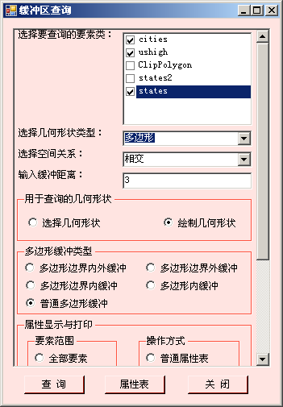
9.4 缓冲区查询
根据选择或绘制的几何形状建立缓冲区，再根据选择的空间关系，查找要素图层上满足条件的记录。

Slide 58
实现的主要代码
private void btnBuffer_Click(object sender, EventArgs e)
  { DeleteGraphics();
  if (rdoSelGeom.Checked)
  SaveSelectedFeaturesToQueryFeatureClass();
  IGeometryCollection geometries = CreateBufferPolygons();
  if (geometries == null) return;
  StopEditTempLayer(IsExistTempLayer(), true);
  SetAllLayersSelectable();
  ExecuteQuery(geometries);
  }

Slide 59
private void ExecuteQuery( IGeometryCollection geometries)
  { if (queryFeatureClass == null || queryFeatureClass.FeatureCount(null) == 0)
  return;
  foreach (object itemChecked in chklstLayers.CheckedItems)
  { SelectOneLayer(itemChecked.ToString(), geometries); }
  }

Slide 60
private void SelectOneLayer(string queriedLayer, IGeometryCollection geometries)
  { IFeatureLayer featureLayer = GetFeatureLayer(queriedLayer);
  IFeatureSelection featureSelection = featureLayer as IFeatureSelection;
  ISpatialFilter spatialFilter = new SpatialFilterClass();
  for (int i = 0; i < geometries.GeometryCount; i++)
  { spatialFilter.Geometry = geometries.get_Geometry(i);
  spatialFilter.GeometryField = featureLayer.FeatureClass.ShapeFieldName;
  switch (strSpatialRelationship)
  { case "相交": spatialFilter.SpatialRel = esriSpatialRelEnum.esriSpatialRelIntersects; break;
  case "包含": spatialFilter.SpatialRel = esriSpatialRelEnum.esriSpatialRelContains; break;
  case "被包含": spatialFilter.SpatialRel = esriSpatialRelEnum.esriSpatialRelWithin; break;
  default: break; } featureSelection.SelectFeatures(spatialFilter,esriSelectionResultEnum.esriSelectionResultAdd,false);
  } }

Slide 61
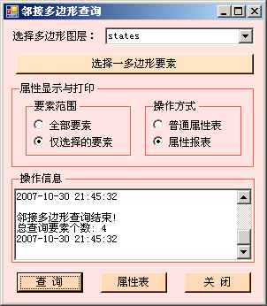
9.5 邻接多边形查询
选择一多边形要素，查找其邻接多边形。

Slide 62
实现的主要代码
public partial class QueryAdjacentFeatures : Form
  { IApplication m_application = null;
  IHookHelper m_hookHelper = null;
  IActiveView m_activeView = null;
  IMap m_map = null;
  IMapControl3 m_mapControl = null;
  IEditor m_editor = null;
  IFeatureLayer currentLayer = null;
  bool displaySelectedFeatures = true;
  bool displayViaReport = true;

Slide 63
public QueryAdjacentFeatures(IHookHelper hookHelper)
  { InitializeComponent();
  m_hookHelper = hookHelper;
  m_activeView = m_hookHelper.ActiveView;
  m_map = m_hookHelper.FocusMap;
  if (m_hookHelper.Hook is IApplication)
  { m_application = m_hookHelper.Hook as IApplication;
  UID uID = new UID();
  uID.Value = "esriEditor.Editor";
  if (m_application == null) return;
  m_editor = m_application.FindExtensionByCLSID(uID) as IEditor; }
  if (m_hookHelper.Hook is IToolbarControl)
  { IToolbarControl toolbarControl = m_hookHelper.Hook as IToolbarControl;
  m_mapControl = (IMapControl3)toolbarControl.Buddy; }
  if (m_hookHelper.Hook is IMapControl3)
  m_mapControl = m_hookHelper.Hook as IMapControl3;
  }

Slide 64
private void frmSelectAdjacentFeatures_Load(object sender, EventArgs e)
  { CboAddItems(cbxPolygonLayers, esriGeometryType.esriGeometryPolygon);
  }
  private void CboAddItems(ComboBox cbo, esriGeometryType geometryType)
  { IFeatureLayer featureLayer;
  IEnumLayer layers = GetLayers();
  if (layers == null) return;
  layers.Reset(); ILayer layer = layers.Next();
  while (layer != null)
  { if (layer is IFeatureLayer)
  { featureLayer = layer as IFeatureLayer;
  if (featureLayer.FeatureClass.ShapeType == geometryType)
  { cbo.Items.Add(layer.Name); }
  }
  layer = layers.Next();
  }
  }

Slide 65
private void cbxPolygonLayers_SelectedIndexChanged(object sender, EventArgs e)
  {
  string strSelectedLayer = cbxPolygonLayers.SelectedItem.ToString();
  currentLayer = GetFeatureLayer(strSelectedLayer);
  SetCurrentLayerSelectable(strSelectedLayer);
  }
  private void btnSelectOnePolygon_Click(object sender, EventArgs e)
  {
  m_map.ClearSelection();
  SetSelectToolAsCurrentTool();
  }

Slide 66
private void btnQuery_Click(object sender, EventArgs e)
  { DeleteGraphics();
  IFeatureSelection featureSelection = currentLayer as IFeatureSelection;
  ISelectionSet selectionSet = featureSelection.SelectionSet;
  IEnumIDs selectedIDs = selectionSet.IDs;
  selectedIDs.Reset(); int selectedID = selectedIDs.Next();
  IFeature baseFeature = currentLayer.FeatureClass.GetFeature(selectedID);
  if (baseFeature != null)
  { IGeometry baseGeom = baseFeature.Shape;
  ISpatialFilter pSFilter = new SpatialFilterClass();
  pSFilter.Geometry = baseGeom; pSFilter.GeometryField = "Shape";
  pSFilter.SpatialRel = esriSpatialRelEnum.esriSpatialRelTouches;
  featureSelection.SelectFeatures(pSFilter, esriSelectionResultEnum.esriSelectionResultNew, false); }
  m_activeView.PartialRefresh(esriViewDrawPhase.esriViewGeoSelection, null, m_activeView.Extent);
  DrawGraphics(baseFeature.ShapeCopy);
  }

Slide 67
9.6 空间分析基础
9.6.1 空间拓扑运算
空间几何图形的拓扑运算包括：
  交集(Intersect)
  并集(Union)
  裁切(Clip)
  差分(Difference)
  对称差分(又称为异或，Symmetric difference)
  凸多边形(Convex hull)
  切割(Cut)
  ……
ITopologicalOperator- ITopologicalOperator5定义了拓扑运算相关操作。

Slide 68
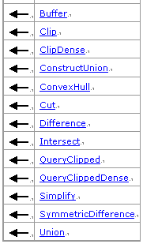

ITopologicalOperator接口
ITopologicalOperator接口仅仅能使用在高级几何对象上，即Point、Multipoint、Polyline和Polygon；如果要使用在低等级的几何对象上，如Segment、Path或Ring上，它们需要先组合成高级别几何对象才行。

Slide 69
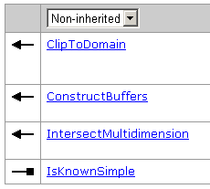
ITopologicalOperator2接口
继承ITopologicalOperator

Slide 70
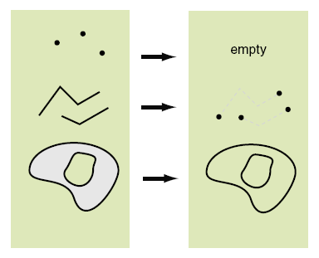
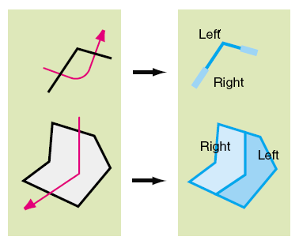
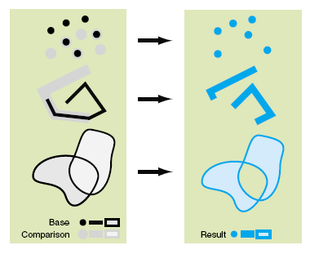
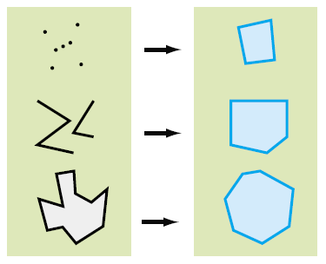
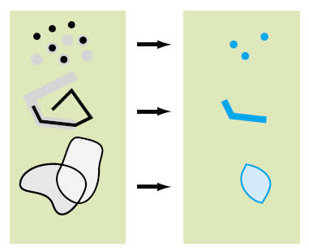
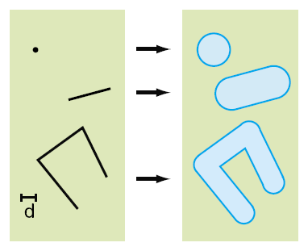
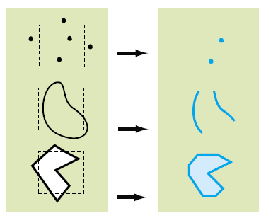
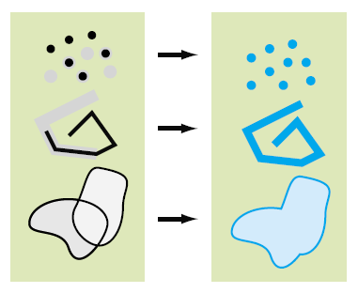
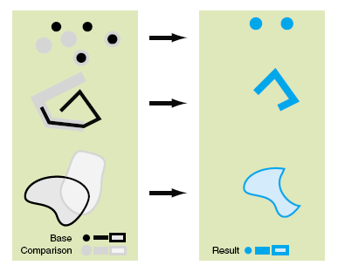

几何对象的边界（Boundary）
SymmetricDifference
几何对象的缓冲区操作（Buffer）
Intersection方法
ConvexHull方法
Union方法
Clip方法
Cut方法
Difference

Slide 71
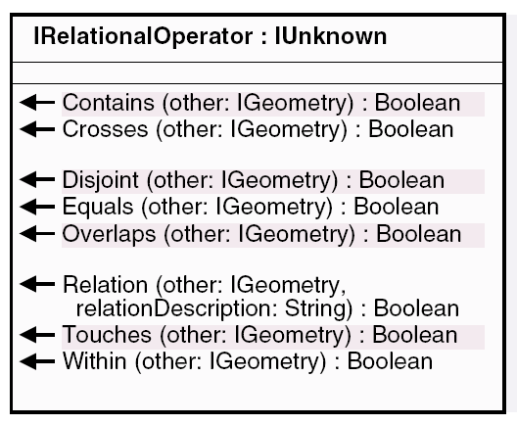
9.6.2 空间关系运算
IRelationaloperator接口
  用于判断2个几何对象间是否存在某种空间关系

Slide 72
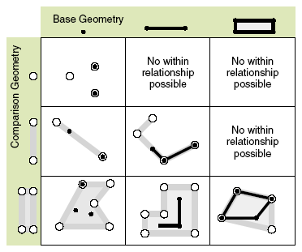
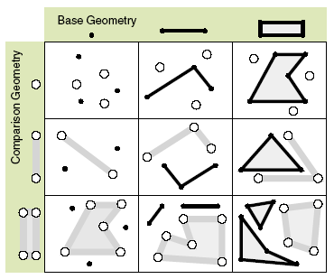
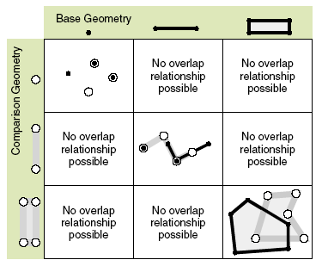
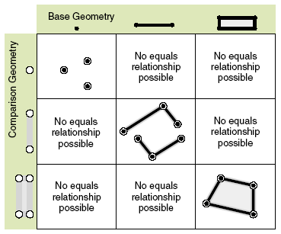
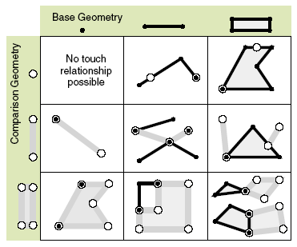
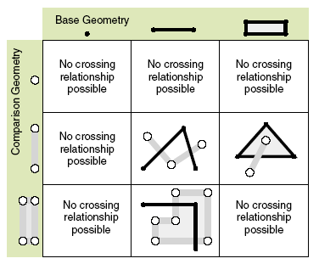
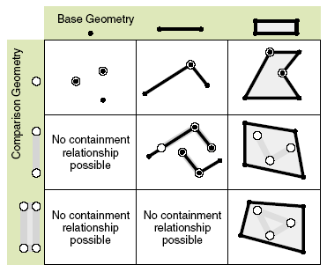
Does the current geometry touch the other geometry?
Is the current geometry within the other geometry
Is the current geometry disjoint from the other geometry?
Does the current geometry overlap the other geometry?
Does the current geometry cross the other geometry ？
Does the current geometry equal the other geometry?
Does the current geometry contain the other geometry?

Slide 73
IProximityOperator接口
IProximityOperator接口定义的方法：QueryNearestPoint、ReturnDistance、ReturnNearestPoint，主要用于得到两个几何对象之间的距离或得到一个给定点到某个几何对象的最近点之间的距离。
在很多GIS系统中都需要拥有“长度量算”的功能，而这个功能就可以使用该接口定义的ReturnDistance方法。

Slide 74
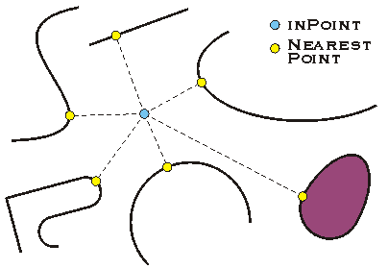
IProximityOperator接口被众多几何对象的类所实现，包括BezierCurve、CircularArc、EllipticArc、Envelope、Line、Multipoint、Point、Polygon和Polyline对象。
Distance2Points 实例
最近点查询

Slide 75
9.7 地学处理工具--Geoprocessing Tools
ArcGIS桌面通过ArcToolbox提供了大量的地学处理工具(Geoprocessing Tools) ，在AO/AE中， ArcToolbox中的每个工具都有一个对应的类。

Slide 76

Toolbox names and namespaces
Toolbox names | Namespaces
3D Analyst tools | ESRI.ArcGIS.Analyst3DTools
Analysis tools | ESRI.ArcGIS.AnalysisTools
Conversion tools | ESRI.ArcGIS.ConversionTools
Data Management tools | ESRI.ArcGIS.DataManagementTools
Cartography tools | ESRI.ArcGIS.CartographyTools
Coverage tools | ESRI.ArcGIS.CoverageTools
Geocoding tools | ESRI.ArcGIS.GeocodingTools
Geostatistical Analyst tools | ESRI.ArcGIS.GeostatisticalAnalystTools
Linear Referencing tools | ESRI.ArcGIS.LinearReferencingAnalystTools
Multidimension tools | ESRI.ArcGIS.MultidimensionTools
Network Analyst tools | ESRI.ArcGIS.NetworkAnalystTools
Spatial Analyst tools | ESRI.ArcGIS.SpatialAnalystTools
Spatial Statistics tools | ESRI.ArcGIS.SpatialStatisticsTools

Slide 77
How to run a geoprocessing tool
You can run a geoprocessing tool by using the Geoprocessing library methods or by the geoprocessor managed assembly methods.
  Using the geoprocessing assembly
  Using the geoprocessor managed assembly

Slide 78
Using the geoprocessing assembly
The Execute method of the IGeoProcessor2 interface of the library is used to run a tool.
The following are the generic steps to execute a tool:
  Add a reference to ESRI.ArcGIS.Geoprocessing to your project.
  Create the GeoProcessorClass object.
  Add the path to the custom toolbox if you are running a custom tool.
  Create an IVariantArray and populate it with tool parameter values. The IVariantArray is available through the esriSystem library.
  Call the Execute method on the geoprocessor.

Slide 79
  using ESRI.ArcGIS.esriSystem;
  using ESRI.ArcGIS.Geoprocessing;
private static void RunBuffer()
  {
  IGeoProcessor2 gp = new GeoProcessorClass();
  IVariantArray parameters = new VarArrayClass();
  parameters.Add(@"D:\St_Johns\data.mdb\roads");
  parameters.Add(@"D:\St_Johns\data.mdb\roads_Buffer");
  parameters.Add("1000 Meters");
  gp.Execute("Buffer_analysis", parameters, null);
  }
public IGeoProcessorResult Execute ( string Name, IVariantArray ipValues, ITrackCancel pTrackCancel);

Slide 80
public void SampleCalculateBestPathTool()
  {
  IGeoProcessor2 gp = new GeoProcessorClass();
  gp.AddToolbox(@"C:\SanDiego\BestPath.tbx");
  IVariantArray parameters = new VarArrayClass();
  parameters.Add(@"C:\SanDiego\source.shp");
  parameters.Add(@"C:\SanDiego\destination.shp");
  parameters.Add(@"C:\SanDiego\bestpath.shp");
  gp.Execute("CalculateBestPath", parameters, null);
  }

Slide 81
Using the geoprocessor managed assembly
The following are the general steps to run a tool:
  Add a reference to ESRI.ArcGIS.Geoprocessor. You might also need to add the ESRI.ArcGIS.Geoprocessing assembly if you want to use, for example, the result object or list datasets.
  Additionally, add a reference to the toolbox assembly to which the tool belongs. If you use more than one tool from different toolboxes, also add managed assemblies for those toolboxes.
  Create the geoprocessor object.
  Add the path to the custom toolbox if you are running a custom tool.
  Create a tool process object and set the parameter values.
  Call the Execute method on the geoprocessor.

Slide 82
  using ESRI.ArcGIS.Geoprocessor;
  using ESRI.ArcGIS.AnalysisTools;
  // Initialize the geoprocessor.
  Geoprocessor GP = new Geoprocessor();
  Erase eraseTool = new Erase(@"C:\Data\Input.shp", @"C:\Data\Erase.shp", @"C:\Data\Output.shp");
  Or use the following code example:
  Erase eraseTool = new Erase();
  eraseTool.in_features = @"C:\Data\Input.shp"; eraseTool.erase_features = @"C:\Data\Erase.shp"; eraseTool.out_featureEclass = @"C:\Data\output.shp";
  GP.Excute(eraseTool ,null);

Slide 83
Running a geoprocessing tool
  // Initialize the geoprocessor.
  Geoprocessor GP = new Geoprocessor();
  ESRI.ArcGIS.AnalysisTools.Buffer bufferTool = new ESRI.ArcGIS.AnalysisTools.Buffer();
  bufferTool.in_features = @"D:\St_Johns\data.mdb\roads_Buffer";
  bufferTool.out_feature_class = @"D:\St_Johns\data.mdb\roads";
  bufferTool.buffer_Distance_or_field = "distance";
  GP.Execute(bufferTool, null);
public object Execute(IGPProcess, ITrackCancel);
public object Execute(string, IVariantArray, ITrackCancel);

Slide 84
Executing a tool by name
  Geoprocessor GP = new Geoprocessor();
  // Add the BestPath toolbox. GP.AddToolbox(@"C:\SanDiego\BestPath.tbx");
  // Generate the array of parameters.
  IVariantArray parameters = new VarArrayClass();
  parameters.Add(@"C:\SanDiego\source.shp");
  parameters.Add(@"C:\SanDiego\destination.shp");
  parameters.Add(@"C:\SanDiego\bestpath.shp");
  // Execute the model tool by name.
  GP.Execute("CalculateBestPath", parameters, null);

Slide 85
private IGeoProcessorResult IntersectOverlay( Geoprocessor gp)
  { IGpValueTableObject vtobject = new GpValueTableObjectClass();
  vtobject.SetColumns(1);
  object row = null;
  row = GetFeatureLayer(strInputLayer); vtobject.AddRow(ref row);
  row = GetFeatureLayer(strOverLayer); vtobject.AddRow(ref row);
  IVariantArray pVarArray = new VarArrayClass();
  pVarArray.Add(vtobject);
  pVarArray.Add(outputFullPath);
  pVarArray.Add(strJoinAttributeType);
  pVarArray.Add(tolerance);
  pVarArray.Add(strOutputFeatureType);
  // Execute the Intersect tool.
  IGeoProcessorResult results = gp.Execute("intersect_analysis", pVarArray, null) as IGeoProcessorResult;
  return results;
  }

Slide 86
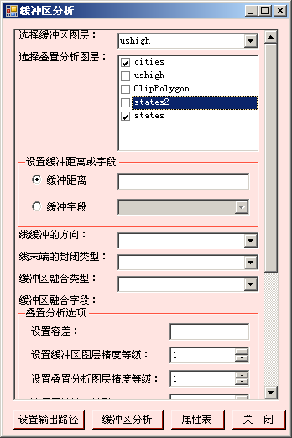
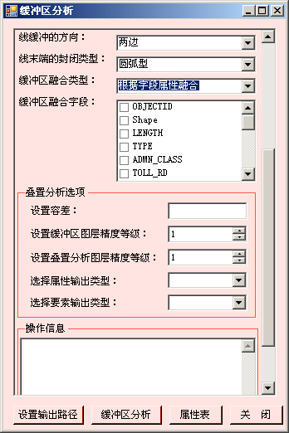
9.8 缓冲区分析
根据选择图层创建缓冲区，然后将选择的叠置图层与缓冲区图层进行叠置分析。

Slide 87
  Buffer_analysis (in_features, out_feature_class, buffer_distance_or_field, line_side, line_end_type, dissolve_option, dissolve_field)
  Intersect_analysis (in_features, out_feature_class, join_attributes, cluster_tolerance, output_type)

Slide 88
实现的主要代码
private void btnBufferAnalysis_Click(object sender, EventArgs e)
  { Geoprocessor gp = new Geoprocessor();
  gp.OverwriteOutput = true;
  gp.AddOutputsToMap = true;
  IGeoProcessorResult results = CreateBuffer(gp);
  if ((results != null) && (results.Status == esriJobStatus.esriJobSucceeded))
  {
  BufferOverlayAnalysis(gp);
  }
  gp = null;
  }

Slide 89
private IGeoProcessorResult CreateBuffer(Geoprocessor gp)
  { ESRI.ArcGIS.AnalysisTools.Buffer buffer = new Buffer();
  IFeatureLayer bufferLayer = GetFeatureLayer(strBufferLayer);
  buffer.in_features = bufferLayer;
  bufferedFeatureClassName = strBufferLayer + "_" + "Buffer";
  string outputFullPath = System.IO.Path.Combine(strOutputPath, bufferedFeatureClassName);
  buffer.out_feature_class = outputFullPath;
  buffer.buffer_distance_or_field = bufferDistanceField;
  buffer.line_side = strSideType;
  buffer.line_end_type = strEndType;
  buffer.dissolve_option = strDissolveType;
  buffer.dissolve_field = strDissolveFields;
  IGeoProcessorResult results = (IGeoProcessorResult)gp.Execute(buffer, null);
  return results; }

Slide 90
private void BufferOverlayAnalysis(Geoprocessor gp)
  { foreach (object itemChecked in chklstOverlayLayers.CheckedItems)
  {
  BufferOverlayAnalysisOneLayer(itemChecked.ToString(), gp);
  }
  }

Slide 91
  private IGeoProcessorResult BufferOverlayAnalysisOneLayer(string layerName, Geoprocessor gp)
  { IGpValueTableObject vtobject = new GpValueTableObjectClass();
  vtobject.SetColumns(1); object row1 = "";
  row1 = GetFeatureLayer(layerName); vtobject.AddRow(ref row1);
  object row2 = "";
  string outputFullOverlay = System.IO.Path.Combine(strOutputPath, bufferedFeatureClassName);
  row2 = outputFullOverlay + ".shp"; vtobject.AddRow(ref row2);
  IVariantArray pVarArray = new VarArrayClass();
  pVarArray.Add(vtobject);
  string outputFullPath = System.IO.Path.Combine(strOutputPath, layerName + "_" + "BufferOverlay.shp");
  pVarArray.Add(outputFullPath); pVarArray.Add(strJoinAttributeType);
  pVarArray.Add(tolerance); pVarArray.Add(strOutputFeatureType);
  IGeoProcessorResult results = gp.Execute("Intersect_analysis", pVarArray, null) as IGeoProcessorResult;
  return results;
  }

Slide 92
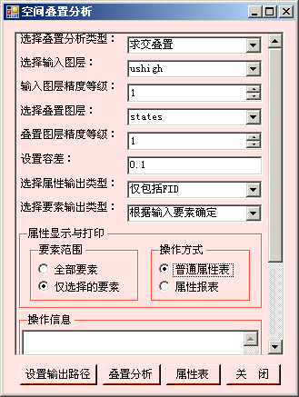
9.9 空间叠加分析
根据选择的叠置分析类型（求交叠置、求和叠置、擦除叠置、同一性叠置、更新叠置、异或叠置），对选择的输入图层和叠置图层进行空间叠置分析。

Slide 93
private void btnOverlay_Click(object sender, EventArgs e)
  { if (strInputLayer == "" || strOverLayer == "") return;
  Geoprocessor gp = new Geoprocessor(); gp.OverwriteOutput = true;
  gp.AddOutputsToMap = true; IGeoProcessorResult results = null;
  switch (strOveralyerType)
  { case "求交叠置":
  results = IntersectOverlay(gp); break;
  case "求和叠置":
  results = UnionOverlay(gp); break;
  case "擦除叠置":
  results = EraseOverlay(gp); break;
  case "同一性叠置":
  results = IdentityOverlay(gp); break;
  case "更新叠置":
  results = UpdateOverlay(gp); break;
  case "异或叠置":
  results = SymDiffOverlay(gp); break; default: break; }
  }

Slide 94
1）求交叠置（Interset）
Intersect_analysis (in_features, out_feature_class, join_attributes, cluster_tolerance, output_type)
  输入图层、叠加图层都可以是点、线、多边形要素层，还可以设置它们的精度等级
  例如：为判断某区域内公路下的土壤特征，可将土壤图层和公路图层进行叠置求交操作，生成新图层，其中公路将被土壤多边形的边界切割，并继承土壤的属性。根据输出结果，可发现哪条道路建立在易侵蚀土壤上，危险系数较大。

Slide 95
private IGeoProcessorResult IntersectOverlay(Geoprocessor gp)
  { IGpValueTableObject vtobject = new GpValueTableObjectClass();
  vtobject.SetColumns(1); object row = null;
  row = GetFeatureLayer(strInputLayer); vtobject.AddRow(ref row);
  row = GetFeatureLayer(strOverLayer); vtobject.AddRow(ref row);
  IVariantArray pVarArray = new VarArrayClass();
  pVarArray.Add(vtobject);
  string outputFullPath = …
  pVarArray.Add(outputFullPath);
  pVarArray.Add(strJoinAttributeType);
  pVarArray.Add(tolerance);
  pVarArray.Add(strOutputFeatureType);
  IGeoProcessorResult results = gp.Execute("intersect_analysis", pVarArray, null) as IGeoProcessorResult;
  return results;
  }

Slide 96
2）求和叠置（Union）
Union_analysis (in_features, out_feature_class, join_attributes, cluster_tolerance, gaps)
  输入图层和叠加图层都必须是多边形图层，还可以设置它们的精度等级。
  例如：为寻找植被和土壤之间的关系，可将植被图层和土壤图层进行叠置求和操作，生成新的多边形图层，此图层中植被多边形被土壤多边形分割，并继承了土壤的属性。可通过新图层查询植被区，了解其具有的土壤特征，也可生成表达植被和土壤之间关系的报表。

Slide 97
private IGeoProcessorResult UnionOverlay(Geoprocessor gp)
  { IGpValueTableObject vtobject = new GpValueTableObjectClass();
  vtobject.SetColumns(1);
  object row = "";
  row = GetFeatureLayer(strInputLayer);
  vtobject.AddRow(ref row);
  row = GetFeatureLayer(strOverLayer);
  vtobject.AddRow(ref row);
  IVariantArray pVarArray = new VarArrayClass();
  pVarArray.Add(vtobject); string outputFullPath = …
  pVarArray.Add(outputFullPath); pVarArray.Add(strJoinAttributeType);
  pVarArray.Add(tolerance); pVarArray.Add("NO_GAPS");
  IGeoProcessorResult results = gp.Execute("Union_analysis", pVarArray, null) as IGeoProcessorResult;
  return results;
  }

Slide 98
3）擦除叠置（Erase）
Erase_analysis (in_features, erase_features, out_feature_class, cluster_tolerance)
  输入图层可以是点、线、多边形图层，叠加图层必须为多边形图层

Slide 99
private IGeoProcessorResult EraseOverlay(Geoprocessor gp)
  { Erase erase = new Erase();
  IFeatureLayer inputLayer = GetFeatureLayer(strInputLayer);
  erase.in_features = inputLayer;
  IFeatureLayer eraseLayer = GetFeatureLayer(strOverLayer);
  erase.erase_features = eraseLayer;
  string outputFullPath = System.IO.Path.Combine(strOutputPath, strInputLayer + "_" + strOverLayer + "_" + "Erase.shp");
  erase.out_feature_class = outputFullPath;
  erase.cluster_tolerance = tolerance;
  IGeoProcessorResult results = (IGeoProcessorResult) gp.Execute(erase, null);
  return results;
  }

Slide 100
4）同一性叠置（Identity）
Identity_analysis(in_features, identity_features, out_feature_class, join_attributes, cluster_tolerance, relationship)
  输入图层可以是点、线、多边形图层，叠加图层必须为多边形图层

Slide 101
private IGeoProcessorResult IdentityOverlay(Geoprocessor gp)
  { Identity identity = new Identity();
  identity.in_features = GetFeatureLayer(strInputLayer);
  identity.identity_features = GetFeatureLayer(strOverLayer);
  string outputFullPath = System.IO.Path.Combine(strOutputPath, strInputLayer + "_" + strOverLayer + "_" + "Identity.shp");
  identity.out_feature_class = outputFullPath;
  identity.join_attributes = strJoinAttributeType;
  identity.cluster_tolerance = tolerance;
  //identity.relationship =;
  IGeoProcessorResult results = (IGeoProcessorResult) gp.Execute(identity, null);
  return results;
  }

Slide 102
5）更新叠置（Update）
Update_analysis (in_features, update_features, out_feature_class, keep_borders, cluster_tolerance)
  输入图层和叠加图层都必须是多边形图层

Slide 103
private IGeoProcessorResult UpdateOverlay(Geoprocessor gp)
  { Update update = new Update();
  update.in_features = GetFeatureLayer(strInputLayer);
  update.update_features = GetFeatureLayer(strOverLayer);
  string outputFullPath = System.IO.Path.Combine(strOutputPath, strInputLayer + "_" + strOverLayer + "_" + "Update.shp");
  update.out_feature_class = outputFullPath;
  update.keep_borders = "false";
  update.cluster_tolerance = tolerance;
  IGeoProcessorResult results = (IGeoProcessorResult) gp.Execute(update, null);
  return results;
  }

Slide 104
5）异或叠置（SymDiff）
SymDiff_analysis (in_features, update_features, out_feature_class, join_attributes, cluster_tolerance)
  输入图层和叠加图层都必须是多边形图层

Slide 105
private IGeoProcessorResult SymDiffOverlay(Geoprocessor gp)
  {
  SymDiff symDiff = new SymDiff();
  symDiff.in_features = GetFeatureLayer(strInputLayer);
  symDiff.update_features = GetFeatureLayer(strOverLayer);
  string outputFullPath = System.IO.Path.Combine(strOutputPath, strInputLayer + "_" + strOverLayer + "_" + "SymDiff.shp");
  symDiff.out_feature_class = outputFullPath;
  symDiff.join_attributes = strJoinAttributeType;
  symDiff.cluster_tolerance = tolerance;
  IGeoProcessorResult results = (IGeoProcessorResult)gp.Execute(symDiff, null);
  return results;
  }

Slide 106
9.10 网络分析
ArcGIS Engine 提供了内置的命令、工具用于网络分析。
  Sample： C:\Program Files\ArcGIS\DeveloperKit10.0\Samples\ArcObjectsNet\NAEngine

Slide 107
public sealed class NAToolbar : BaseToolbar
  {
  public NAToolbar()
  { AddItem("{daf340c1-4c57-453e-b6b0-eeef0fd36933}"); //NAmenu
  BeginGroup(); //Separator
  AddItem("esriControls.ControlsNetworkAnalystWindowCommand");
  AddItem("esriControls.ControlsNetworkAnalystCreateLocationTool");
  AddItem("esriControls.ControlsNetworkAnalystSelectLocationTool");
  AddItem("esriControls.ControlsNetworkAnalystSolveCommand");
  AddItem("esriControls.ControlsNetworkAnalystDirectionsCommand");
  AddItem("esriControls.ControlsNetworkAnalystLayerToolControl");
  }
  public override string Caption
  { get { return "Network Analyst Toolbar"; }
  }
  public override string Name
  { get { return "NAToolbar"; }
  }
  }

